Slide 1
\
Request for Proposals # 2
TCU Building Bridges Grant Program
A Science, Technology, Engineering & Math (STEM) grant-funding opportunity developed in partnership with the American Indian Higher Education Consortium (AIHEC) and the National Aeronautics and Space Administration (NASA)
Workshop #2:
Community of Practice
Notes:
Welcome! We will take a few more minutes to let folks join the call. While we wait, please do put your name and TCU in the chat

Slide 2
Today’s Agenda
Welcome
Timeline and RFP Overview
RFP Review
Pre-application
Closing & Next Steps

Slide 3
Timeline
& Overview
To guide the application process, four webinars and workshops will be held to provide guidance, highlight best practices, offer resources, outline expectations, and address questions.
Each cycle, 5 webinars will take place to support the proposal development process.
1 – Information Session + Q & A (September 16)
2 – Workshop: Community of Practice (October 4)
3 – Workshop: Building A Competitive Proposal (October 11)
4 – Workshop: Budget Development (October 18)
5 – Office Hours (TBD)
*Webinars will also be recorded and uploaded to AIHEC.org for review
TCU faculty and staff who are interested but are not ready to submit a project are encouraged to attend workshops and learn more about the program, then submit an application for a future cycle.

Slide 4
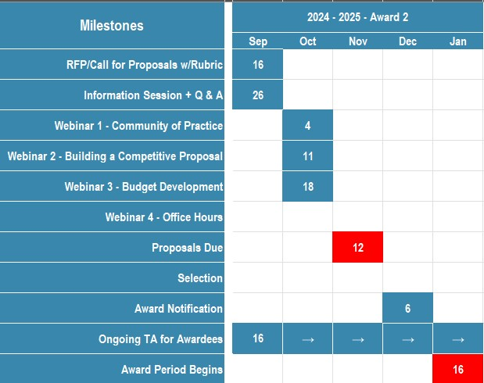
Timeline
& Overview
Notes:
Will be part of intro slides in future sessions

Slide 5
RFP Overview
RFP RELEASE DATE: September 16, 2024
PROPOSAL DUE DATE: 11:59 PM Eastern Time (ET) November 12, 2024
FUNDING AMOUNT: Multiple awards of up to $68,600 are available ($686,000 total each year)
ELIGIBILITY: Funds are available to faculty led teams from all accredited Tribal Colleges & Universities
ESTIMATED CONTRACT PERIOD: January 16, 2025, through January 15, 2027, or up to 2 years (24 months) from date of award, depending on the scope of the project. Projects designed for shorter periods of time will receive equal consideration. If projects last 1 year or less, projects can be renewed for a second cycle with an additional award.

Slide 6
RFP Review
We will look at each section of the RFP together and go over any questions that may arise

Slide 7
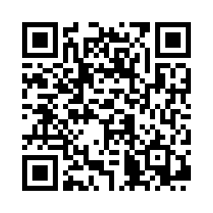
Thank you for coming!
Please complete our survey:
We will come back together next Friday, October 11th for a writing workshop
Notes:
https://app.smartsheet.com/b/form/d7b1cc948a424d849d977da80b65758e

